Slide 1
Creating a Low Cost, 3D Printed VTOL Drone for Accessible Surveillance Solutions
Cadets Rose, Sesay, Wang

Slide 2
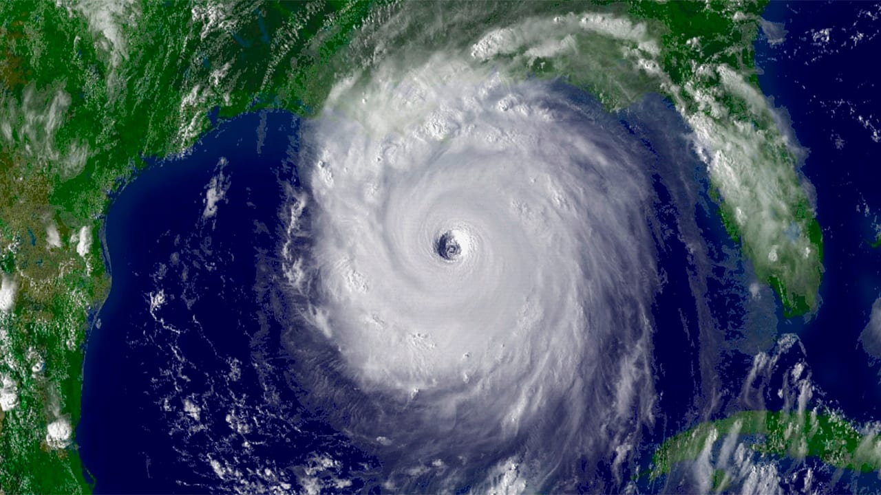
Motivation
Many Natural Disasters
Scout to see survivors that need rescuing
Hopefully a cheap, yet reliable option to help

Slide 3

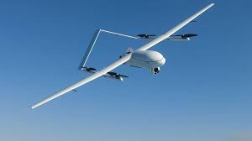
Problem Statement
Our goal is to make cheaper drones that can be used to find survivors of natural disasters

Slide 4
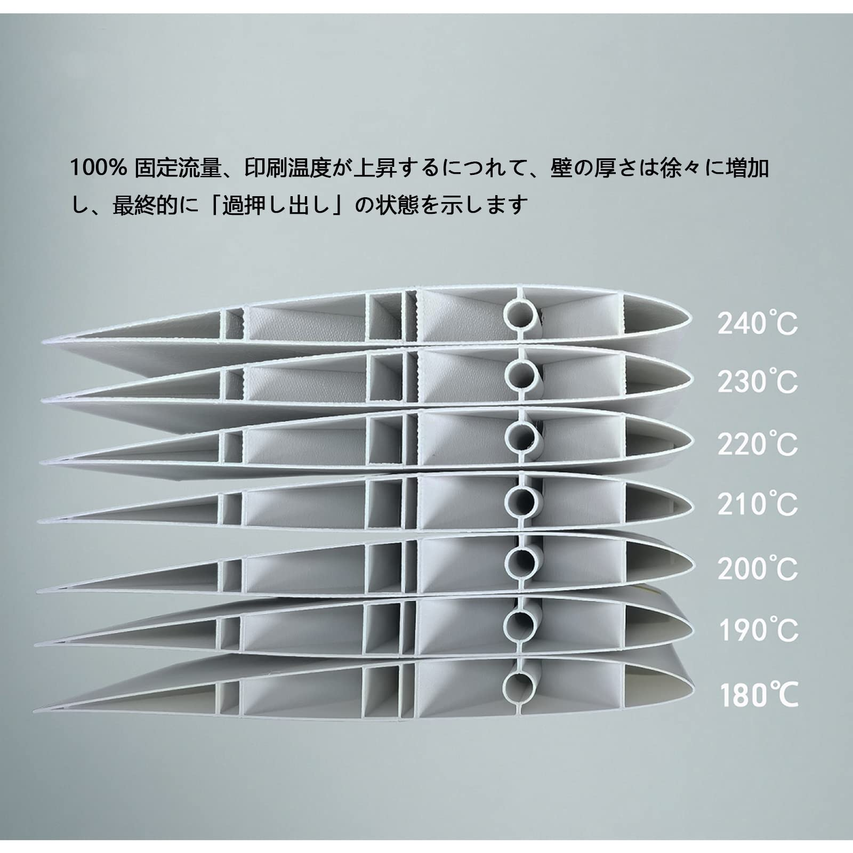
Material Choice
Lightweight Pre-foamed Polylactic Acid (LW-PLA)
Low Cost
Lightweight (30% less density than normal PLA)
Maintains strong structure
Accessible
Harder to print

Slide 5
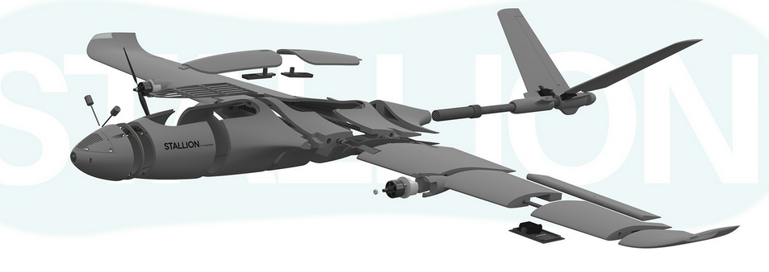
Segmenting
Distributes weight across the drone to maximize efficiency.
60 segments

Slide 6
Hardware
2 Hollow Carbon Fiber Tubes
Super Glue
Small Metric Screws
Threaded inserts
3d Printing

Slide 7
Electronics
Flight Controller = F405-VTOL
Motor = Three Lumenier 51As with 32 bit telemetry support, three T- Motor F90 1300KV motors.
Battery = Medium Sized 4S Battery
First Person = DJI O4 Air Unit and the DJI N3 Goggles

Slide 8
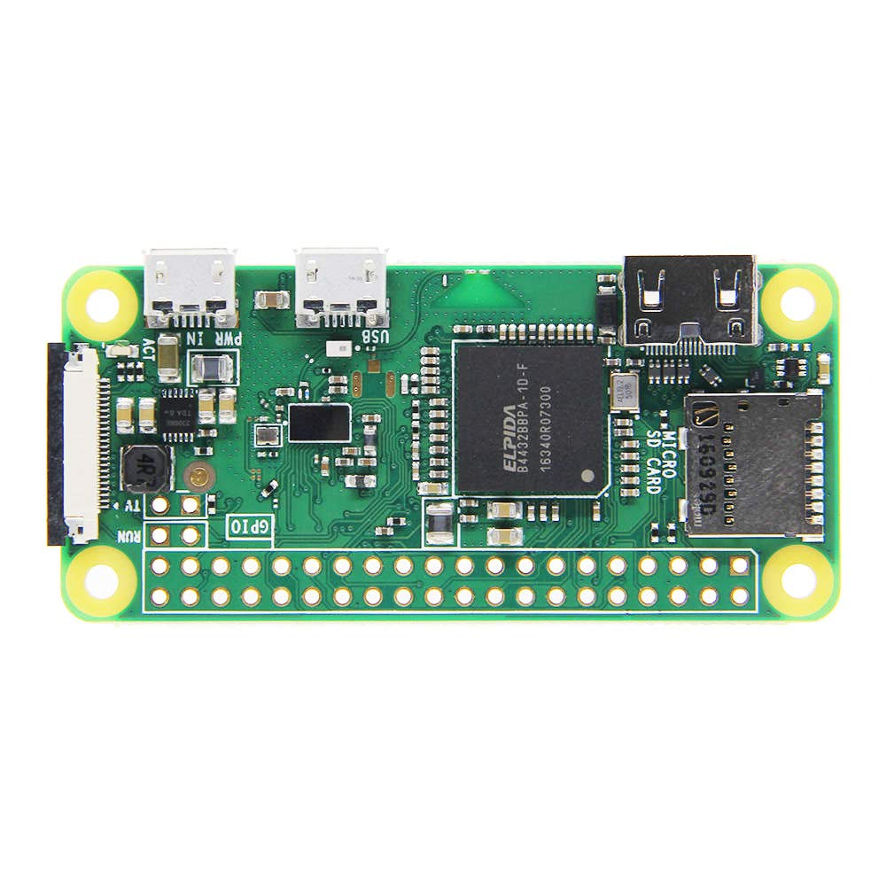
Software
Raspberry Pi 0w
Takes the flight speed and elevation from the flight controller
Computes the intervals to take pictures of the ground.
Splice images into one big image
Extracted from the drone upon landing

Slide 9
Future Work
Find different sources and printers
Flight Test the Drone thoroughly
Extend the range of the connection
Protect camera lens from glare

Slide 10
Works Cited
[1] Stallion vtol user Manual V2, https://flightory.com/wp-content/uploads/2025/02/STALLION-MANUAL-VTOL-V2.pdf (accessed May 2, 2025).
[2] D. Hein, T. Kraft, J. Brauchle, and R. Berger, “Integrated UAV-based real-time mapping for security applications,” MDPI, https://www.mdpi.com/2220-9964/8/5/219 (accessed May 1, 2025).
[3] G. J. J. Ducard, “Review of designs and flight control techniques of hybrid and convertible VTOL uavs,” Aerospace Science and Technology, https://www.sciencedirect.com/science/article/pii/S1270963821005459 (accessed May 1, 2025).
[4] Design and implementation of a low-cost folding-wing UAV for Model Rocket Deployment | IEEE conference publication | IEEE xplore, https://ieeexplore.ieee.org/document/10115901/ (accessed May 2, 2025).
[5] Stallion user manual, https://flightory.com/wp-content/uploads/2024/09/STALLION-MANUAL.pdf (accessed May 2, 2025).

